Slide 1

Machine Learning for Robotics
Week # 12: Regression
Dr. Maryam Iqbal

Slide 2
About Instructor
PhD EE (Controls, Automation & Rehabilitation Robotics)
Research areas: Robotics & Automation, Artificial Intelligence, Machine Learning, Biomechanics, AI in Healthcare
In charge : BSRIS Program at Bahria University
Research Publications, Funded Projects and Patents
Member of AI Task Force (Ministry of Planning, Development & Special Initiatives of Pakistan)
Senior Member IEEE (Region 10)|General Secretary IEEE RAS (Region 3)|Member IEEE CSS
Email: maryamiqbal.buic@bahria.edu.pk
LinkedIn: linkedin.com/in/maryam-iqbal-3b942a66
Google Scholar: https://scholar.google.com/citations?user=-4togNoAAAAJ&hl=en

Slide 3
Multiple Linear regression

Slide 4
multiple linear regression
In statistics, simple linear regression is a linear regression model with a single explanatory variable.
It concerns two-dimensional sample points with one independent variable and one dependent variable (conventionally, the x and y coordinates in a Cartesian coordinate system)
It finds a linear function (a non-vertical straight line) that, as accurately as possible, predicts the dependent variable values as a function of the independent variable.
Simply put, Simple linear regression is used to estimate the relationship between two quantitative variables.

Slide 5

What is MLR
Multiple linear regression is used to estimate the relationship between two or more independent variables and one dependent variable.

Slide 6
What multiple linear regression can help you do
You can use multiple linear regression when you want to know:
How strong the relationship is between two or more independent variables and one dependent variable (e.g. how rainfall, temperature, and amount of fertilizer added affect crop growth).
The value of the dependent variable at a certain value of the independent variables (e.g. the expected yield of a crop at certain levels of rainfall, temperature, and fertilizer addition).

Slide 7
Assumptions of multiple linear regression
Multiple linear regression makes all of the same assumptions as simple linear regression:
The probability distribution of ε is normal.
The mean of ε is zero: E(ε) = 0.
The standard deviation of ε is σ_{ε} for all values of X.
The set of errors associated with different values of Y are all independent

Slide 8
Design Requirements
Two or more independent variables (predictor variables).
Sample size: >= 50 (at least 10 times as many cases as independent variables)

Slide 9

formula for a multiple linear regression
y = the predicted value of the dependent variable
B₀ = the y-intercept (value of y when all other parameters are set to 0)
B₁X₁= the regression coefficient (B₁) of the first independent variable (X₁) (a.k.a. the effect that increasing the value of the independent variable has on the predicted y value)
… = do the same for however many independent variables you are testing
B_{n}X_{n} = the regression coefficient of the last independent variable
e = model error (a.k.a. how much variation there is in our estimate of y)

Slide 10
best-fit line
To find the best-fit line for each independent variable, multiple linear regression calculates three things:
The regression coefficients that lead to the smallest overall model error.
The t-statistic of the overall model.
The associated p-value (how likely it is that the t-statistic would have occurred by chance if the null hypothesis of no relationship between the independent and dependent variables was true).

Slide 11
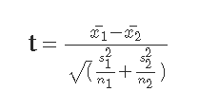
T-test
In statistics, the t-statistic is the ratio of the departure of the estimated value of a parameter from its hypothesized value to its standard error’
It is meant for evaluating whether the two sets of data are statistically significantly different from each other.

Slide 12
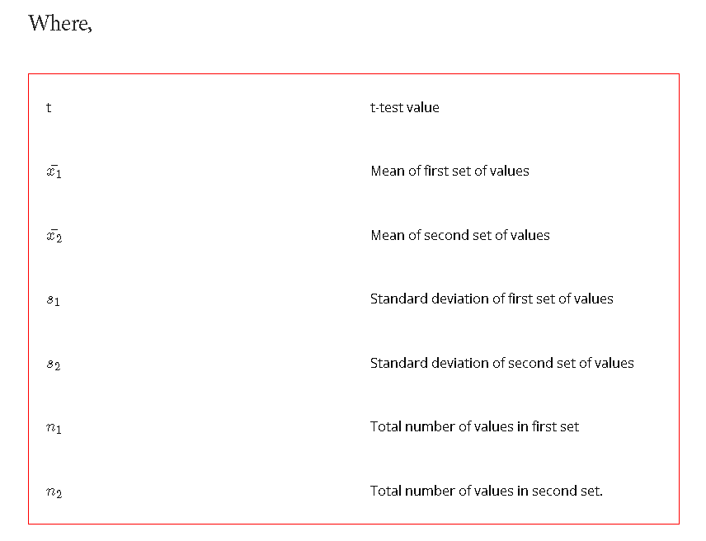

Slide 13
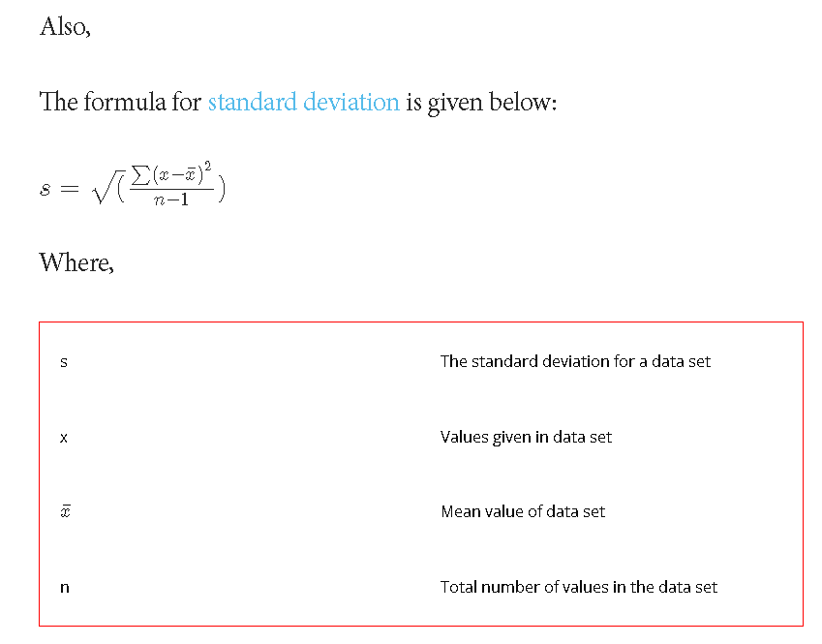

Slide 14
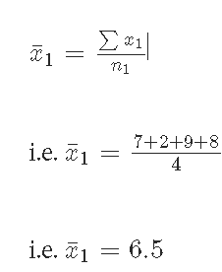
Q.1: Find the t-test value for the following given two sets of values:
A = 7, 2, 9, 8 and
B = 1, 2, 3, 4?
Solution: For first data set:
Number of terms in first set i.e. n_1 = 4
Calculate mean value for first data set using formula:

Slide 15
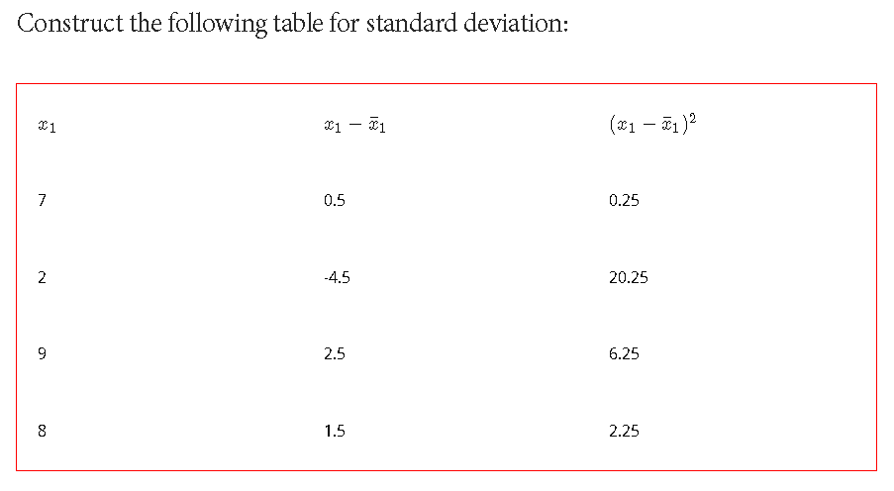

Slide 16
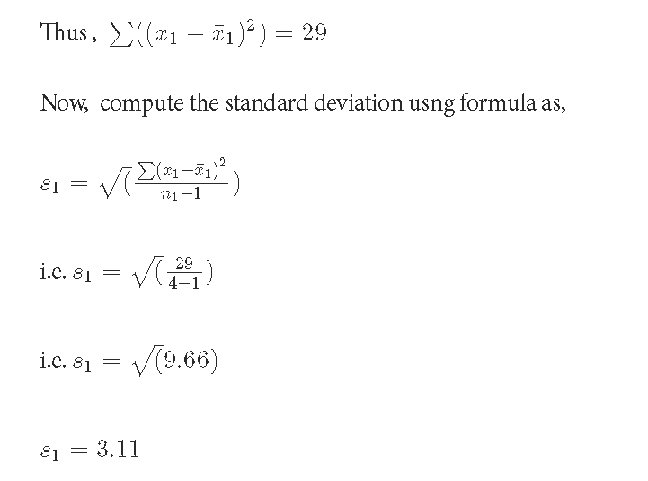

Slide 17
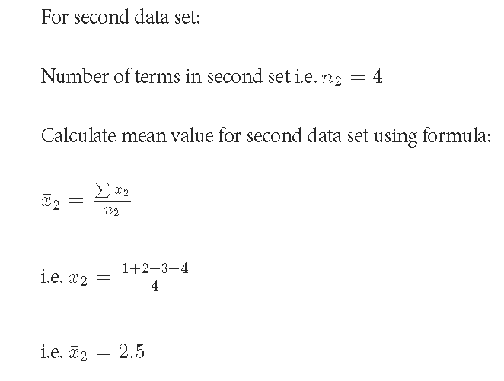

Slide 18
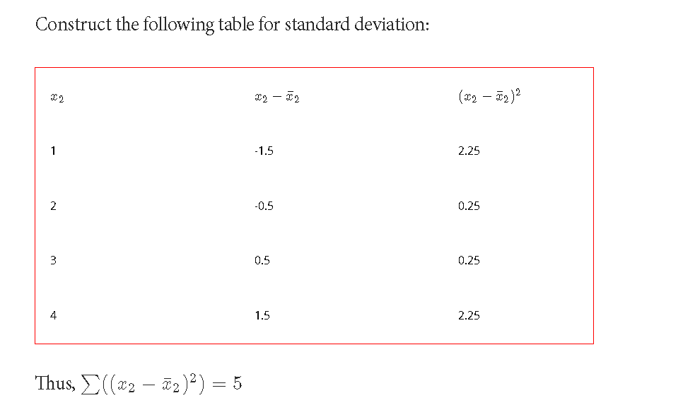

Slide 19
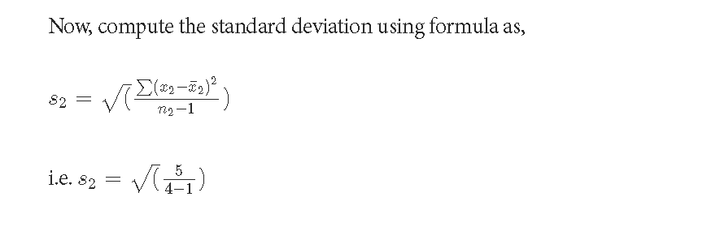


Slide 20
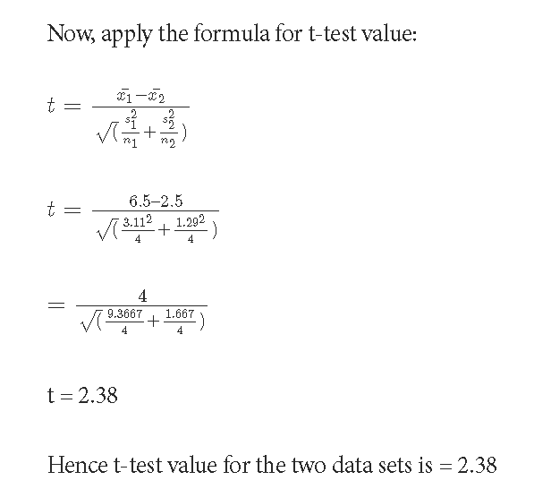

Slide 21

Higher values of the t-value, also called t-score, indicate that a large difference exists between the two sample sets. The smaller the t-value, the more similarity exists between the two sample sets.

Slide 22
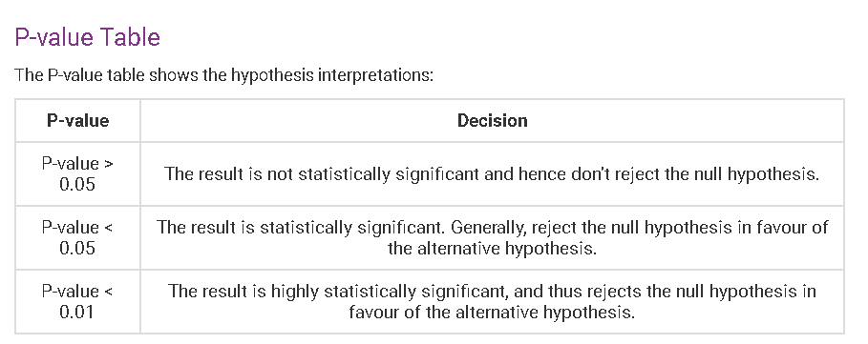
P-value
P-value is the lowest significance level that results in rejecting the null hypothesis.

Slide 23
Example
Coin
Coin toss
Two possible outcomes
H0 = This is a fair coin
H1 = This is not a fair coin
Assume
The P-value test will assume that the H0 hypothesis is true i.e., the coin is fair
Let
Let us assume our threshold value to be 5% i.e., 0.05

Slide 24

Let us assume the output is
First toss output is Tail (probability = 0.5)
First toss output is Tail and second toss output is also Tail (probability = 0.25)
First two outputs same as before, third toss output is also Tail (probability = 0.125)
First three outputs same as before, fourth toss output is also Tail (probability = 0.0625)
First four outputs same as before, fifth toss output is also Tail (probability = 0.03)
First five outputs same as before, sixth toss output is also Tail (probability = 0.01)
After the fourth output the statistical test is significant. Since P-value of less than 5% indicates that the hypothesis H0 is rejected and hypothesis H1 is accepted i.e., the coin is not fair

Slide 25
Selecting the independent variables being used
Five strategies are available for selecting the independent variables
All in
Backward Elimination
Forward Selection
Bi-directional elimination
Score Comparison (All possible combinations)

Slide 26
All in
Use all features
Prior knowledge (Data domain expert) tell you which features to keep and which to discard

Slide 27
Backward Elimination
Select a significance level (SL) for P-value e.g. 5% (0.05)
1
Fit the model will all predictors
2
Consider the predictor with highest P-value. If P>SL go to step 4, otherwise include the predictor in your feature set
3
Remove variable with P>SL
4
Fit model without the variable and go to step 3 if all features have not been exhausted. Otherwise terminate
5

Slide 28
Forward selection
Select
Select a significance level (SL) for P-value e.g. 5% (0.05)
Fit
Fit all the predictors y->xn one at a time and select one with the lowest P-value
Keep
Keep this variable and fit all possible models with one extra predictor i.e., add one predictor to the variables you already have.
Consider
Consider the predictor with the least P-value. If P<SL, go to step 3, otherwise finish. (keep the previous model)

Slide 29
Bi-directional Elimination
Select a significance level to enter (SL_Enter) and stay (SL_stay) in the model.
Perform the next step of forward selection (new variables must enter if P < SL_enter)
Pefrom all steps of backward elimination (old variables must have P<SL_stay to stay in the model)
No new variables can enter and no old variables can exit
FIN: model is ready

Slide 30

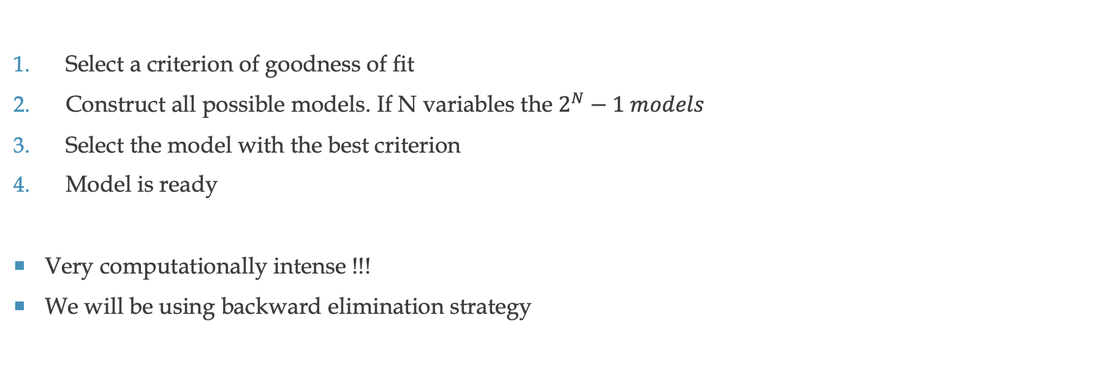
All possible models
Select a criterion of goodness of fit
Construct all possible models. If N variables the $2^{N}−1 models$
Select the model with the best criterion
Model is ready
Very computationally intense !!!
We will be using backward elimination strategy

Slide 31
MLR Implementation
Python

Slide 32

Importing Dataset

Slide 33
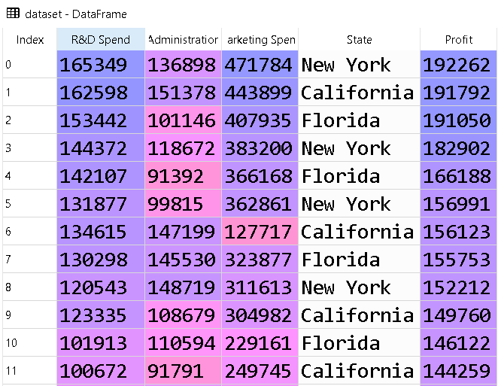
Dataset
Total 50 samples
Three independent variables
Administration
Marketing spent
State (categorical data)
One hot encoding
Three categories, so three dummy variables
One dependent variable
Profit

Slide 34
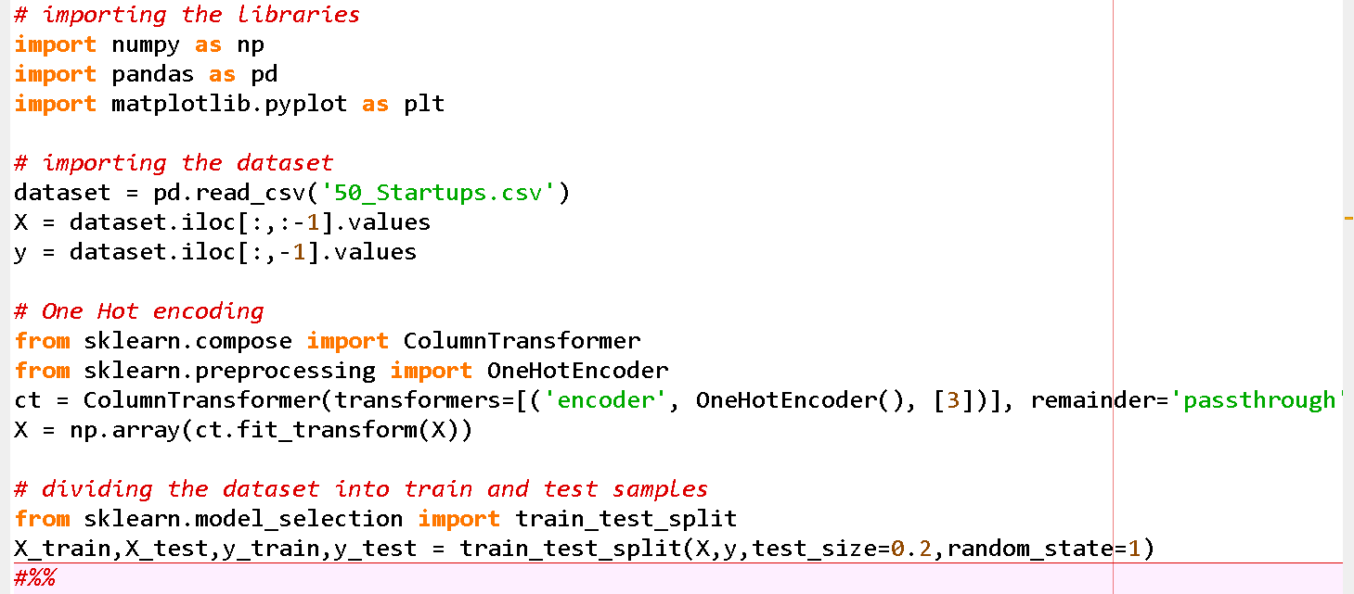
Code
One hot encoding to be applied on column 3
80, 20 split

Slide 35
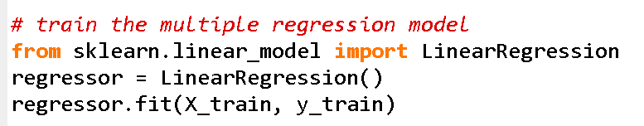
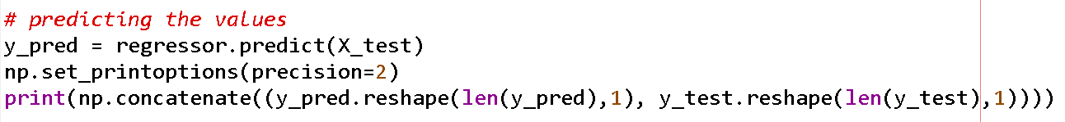
Training and testing the model

Slide 36
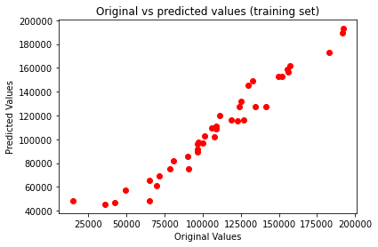
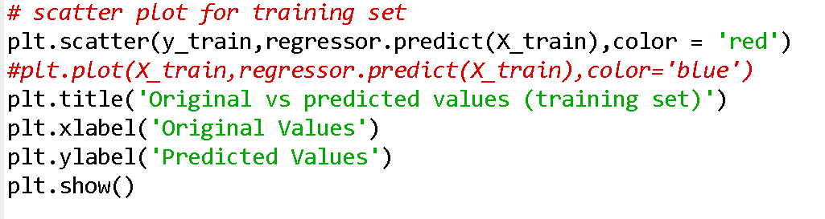

Slide 37
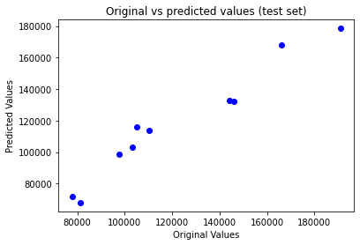
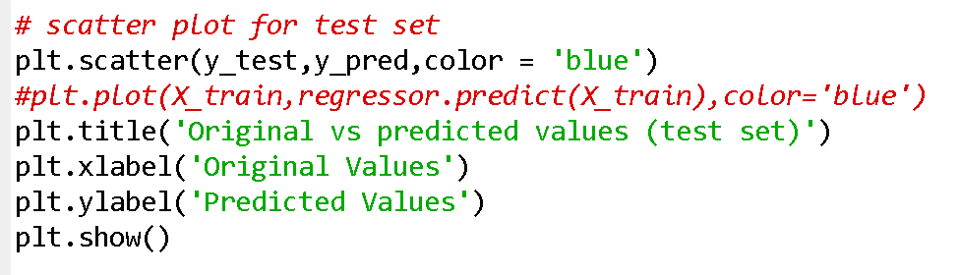

Slide 38
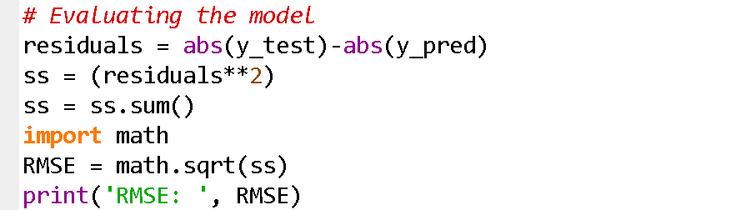
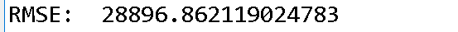

Evaluating the model

Slide 39
to remember
Q: Do we need to normalize the data in MLR
A: No, we do not need to perform normalization for MLR, since the coefficients b0, b1, b2,… in the MLR model automatically does that.
Q: Do we need to check the assumptions of linear regression
A: Absolutely not, for a new dataset play and experiment with it. If there are redundant features it will perform poorly.
Q: Do we need to use some strategy to avoid the dummy variable trap
A: The class used here in python will automatically do that
Q: Do we have to use techniques such as backward elimination etc, before applying MLR.
A: No, because the class we use will automatically do that.

Slide 40
Example of Backward Elimination
Select a significance level (SL) for P-value e.g. 5% (0.05)
Fit the model will all predictors
Consider the predictor with highest P-value. If P>SL go to step 4, otherwise include the predictor in your feature set
Remove variable with P>SL
Fit model without the variable and go to step 3 if all features have not been exhausted. Otherwise terminate

Slide 41
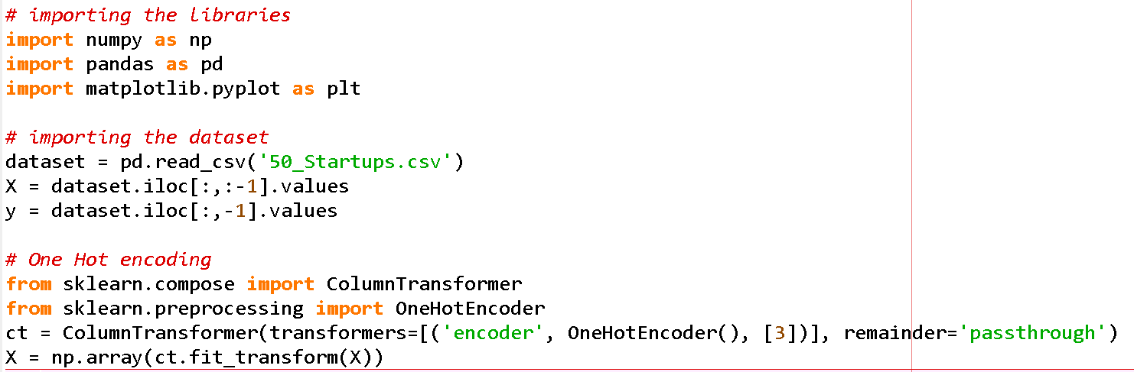
Code
Importing the dataset
Dividing the dataset into independent and dependent variables
One hot encoding for the categorical data
We do not need to cater the missing values as there are none

Slide 42
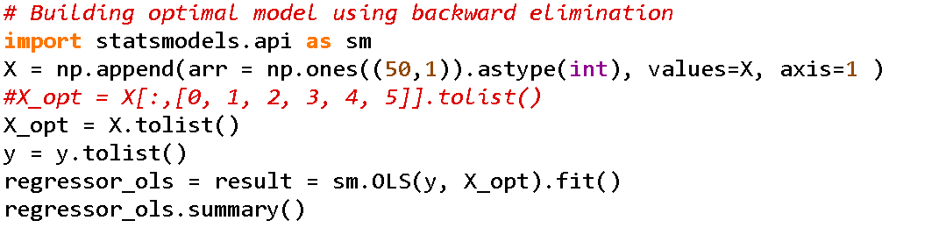
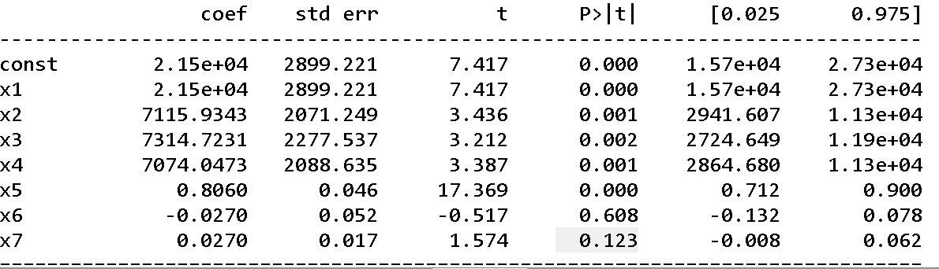
Inserting beta_0
x6 has highest p value, so it should be removed

Slide 43
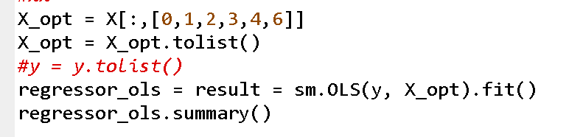
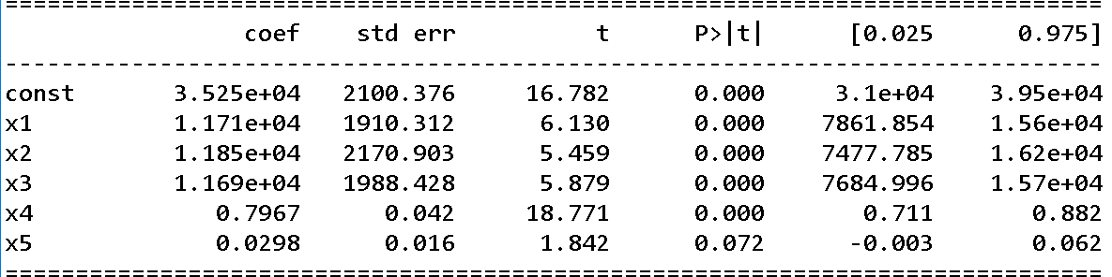
x5 has highest p value so it should be removed

Slide 44
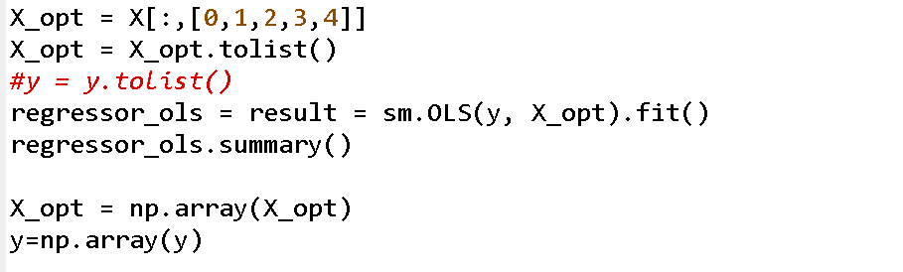
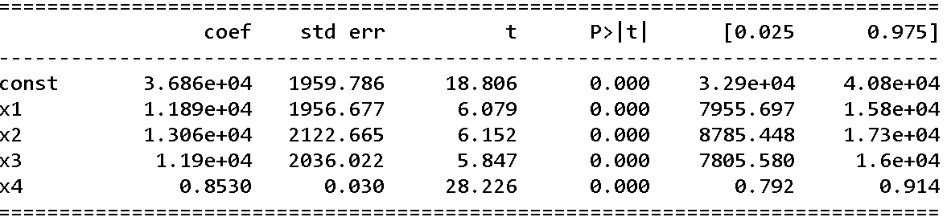
Now no independent variable has a p value >0.05, so we keep the remaining variables

Slide 45
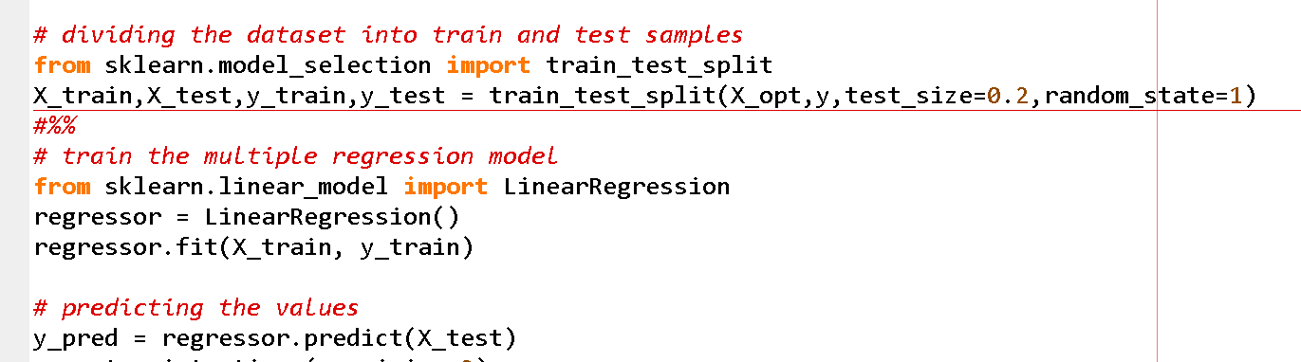

Slide 46
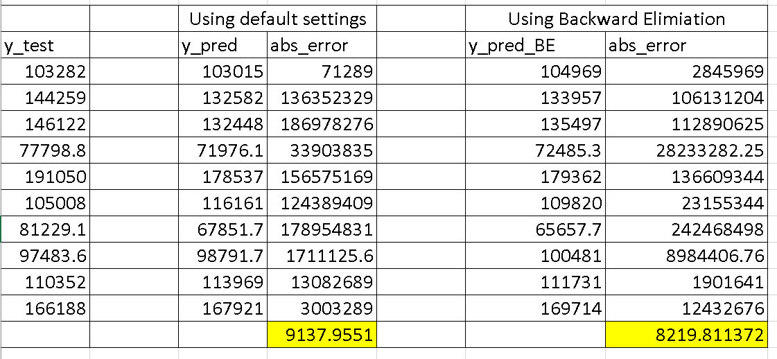
Comparison between two approaches using RMSE
The regression model with backward elimination shows lower RMSE

Slide 47
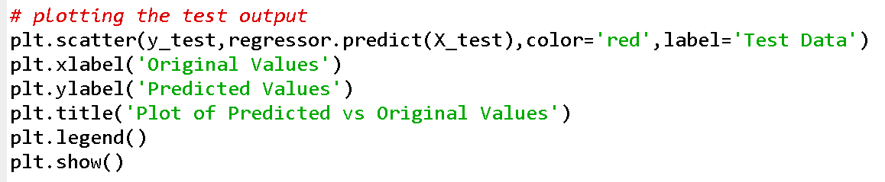
Plotting the output

Slide 48
Example of Forward Selection(Optional)
Select a significance level (SL) for P-value e.g. 5% (0.05)
Fit all the predictors y->xn one at a time and select one with the lowest P-value
Keep this variable and fit all possible models with one extra predictor i.e., add one predictor to the variables you already have.
Consider the predictor with the least P-value. If P<SL, go to step 3, otherwise finish. (keep the previous model)

Slide 49
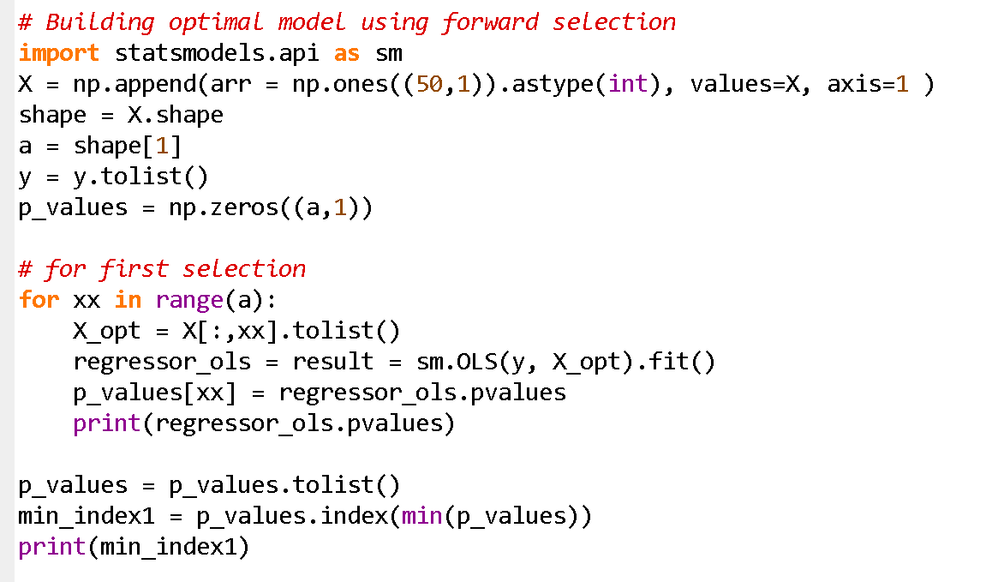

Slide 50
Robot movement dataset
Train Data (traindata1.xlsx) Rows: 3999 Columns: 9 Features: Rev1 to Rev5: Five numerical features representing [description of what these features represent]. Pris: A categorical feature indicating [description of 'Pris']. X, Y, Z: Coordinate points or measurements in a three-dimensional space. Test Data (testdata1.xlsx) Rows: 1003 Columns: 9 Features: Similar to the train data, with Rev1 to Rev5, Pris, and X, Y, Z features. Potential Use-Cases These datasets can be utilized for various machine learning applications.

Slide 51
basics of python

Slide 52
ML Exercise: Robot Kinematics Prediction using Linear Regression
Problem Title:
Predicting Robot End-Effector Position using Linear Regression
Scenario
A robotic system generates motion data based on:
Revolute joints (Rev1–Rev5) → joint angles
Prismatic joint (Pris) → linear displacement type/setting
Output: End-effector position (X, Y, Z) in 3D space
You are given:
Training dataset (traindata1.xlsx) → 3999 samples
Testing dataset (testdata1.xlsx) → 1003 samples

Slide 53
ML Exercise: Robot Kinematics Prediction using Linear Regression
Objective
Develop a Linear Regression model to predict the end-effector position (X, Y, Z) of the robot.
Conceptual Link
Rev joints (Rev1–Rev5) → rotational DOF
Pris (Prismatic joint) → linear DOF
Together → define robot configuration → determine (X, Y, Z)
This is essentially a forward kinematics learning problem via ML.

Slide 54
Task i: simple linear regression
Uses Simple Linear Regression
Learns the relationship between:
Input: Rev1 (one joint angle)
Output: X (robot position)
Plots actual vs predicted values
Computes error (MSE)
👉 In robotics terms: It tries to see how one joint (Rev1) affects the robot’s X-position

Slide 55
Task II: Multiple linear regression
Part A: Data Preprocessing
Load both datasets using Pandas
Identify:
Input features → Rev1–Rev5, Pris
Target variables → X, Y, Z
Convert Pris (categorical) into numerical form (encoding required)
Split features (X) and targets (y)
Part B: Model Development
Apply Multiple Linear Regression
Train the model using training data

Slide 56
Task II: Multiple linear regression
Part C: Prediction
Predict X, Y, Z for test dataset
Display first 10 predicted outputs
Part D: Evaluation
Compute Mean Squared Error (MSE) for X, Y, Z
Comment:
Which coordinate is predicted best?
Why linear regression may be limited for robotic motion?

Slide 57

Any Questions

